Slide 1
Phone Screen Time
By Dennis Campoverde-Lema

Slide 2
Question: is there a significant difference in the average total screen time on weekdays versus weekends?

Slide 3
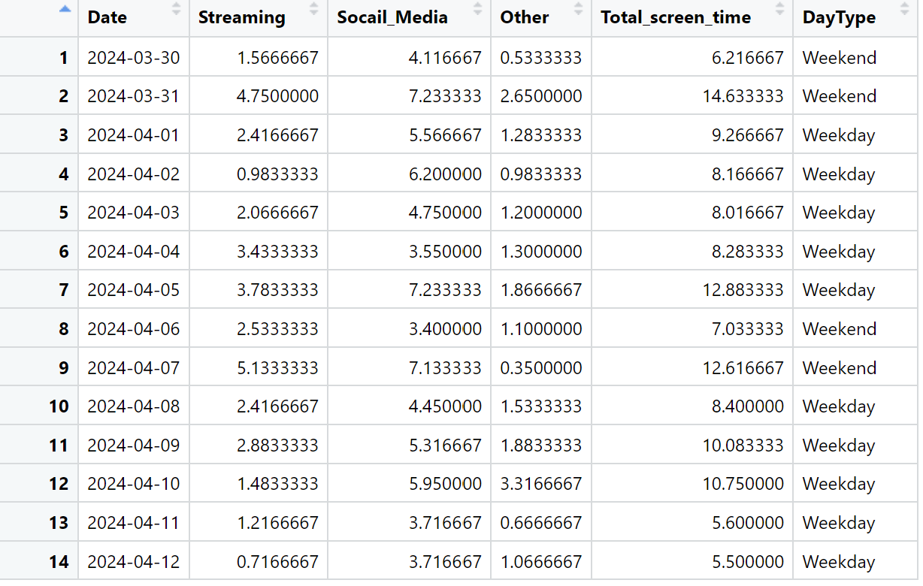
Data
14 Observations
Variables
DayType
Weekend or Weekday
Total_Screen_Time
Used SAMSUNG screen time tracker

Slide 4
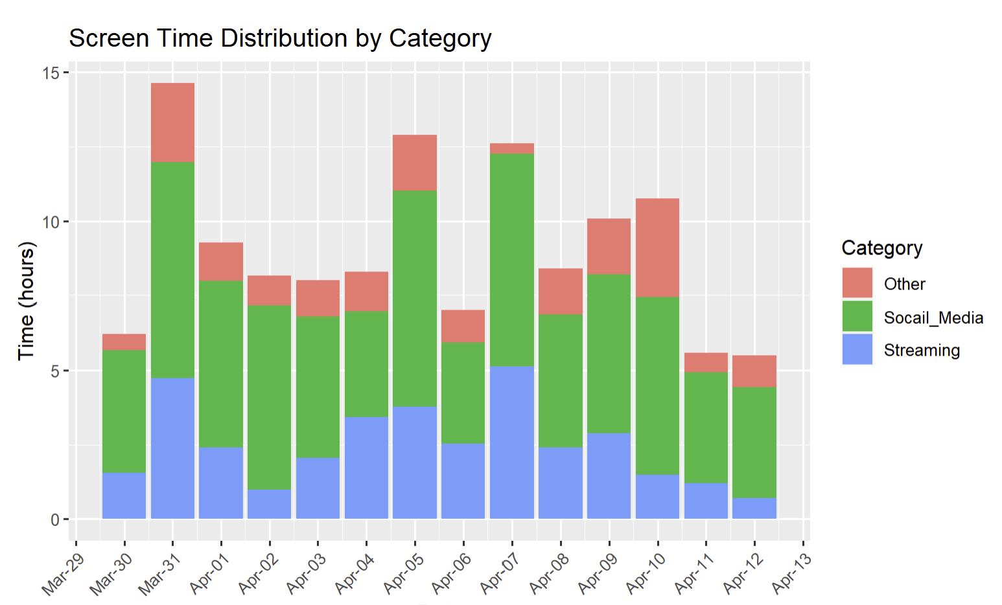
Visualize data

Slide 5
Hypothesis Testing
Claim: The mean total screen time on weekdays is equal to the mean total screen time on weekends.
Variables:
Independent: Day Type (Weekday vs. Weekend)
Dependent: Total Screen Time (measured in hours)

Slide 6
Hypothesis Testing
Step 1
Null Hypothesis
H0:μweekday=μweekend
Alternative Hypothesis
H1:μweekday≠μweekend
Step 2
Use t –test

Slide 7
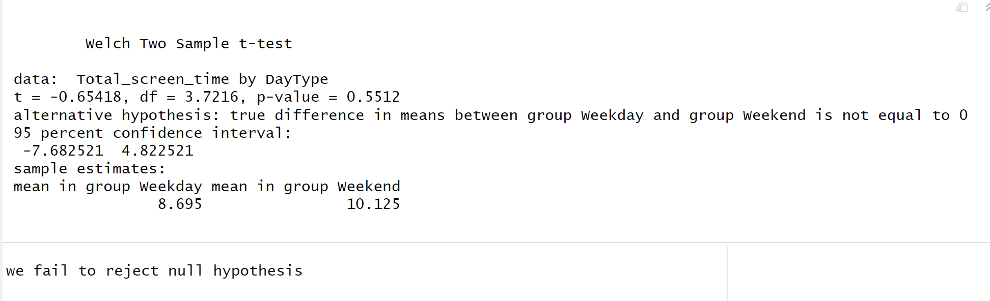
Hypothesis Testing
Step 3
Test Statistic
T = -0.65418
P-value : 0.5512
Step 4
Using a significance level of 0.05, reject the null hypothesis

Slide 8
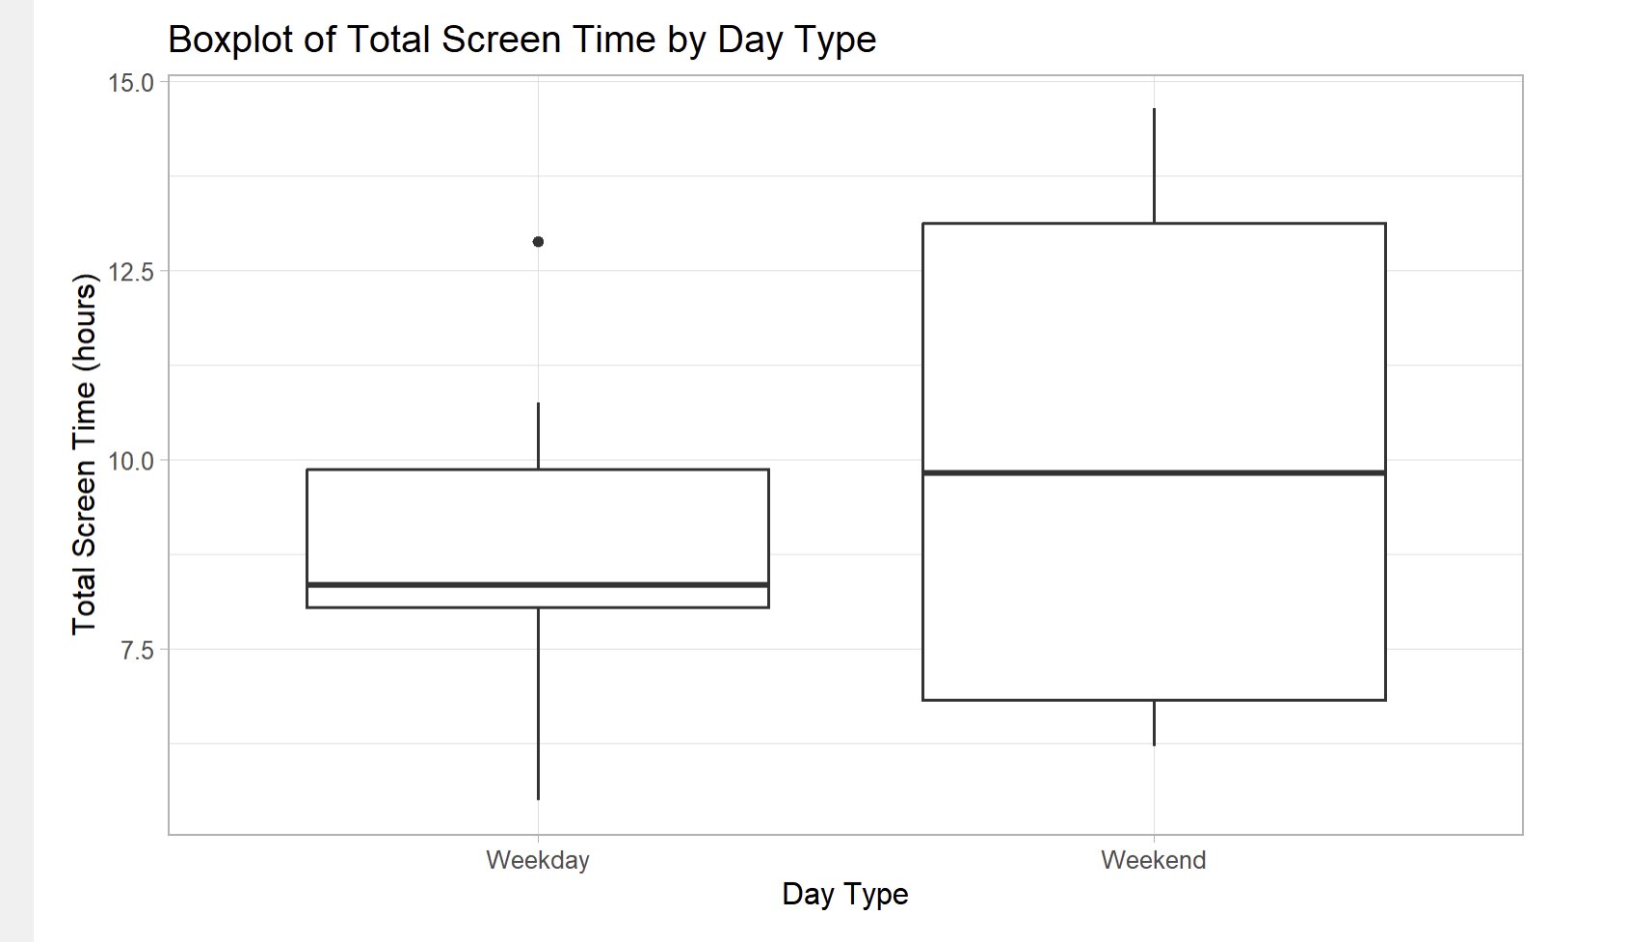
Conclusion
Given that the p-value is 0.5512, which is greater than the commonly used threshold of 0.05, we fail to reject the null hypothesis. There is not enough evidence to conclude that there is a significant difference in the average total screen time between weekdays and weekends. This means, based on your collected data, the average screen time does not significantly differ when comparing weekdays to weekends.

Slide 9
Questions?

